Slide 1
Aflac WorkForces Report
2011 - 2016
Notes:
This presentation reviews the key findings from the Aflac WorkForces Report to help understand what the numbers are telling us about how employees and employers feel about the role of benefits.

Slide 2
Confidential and Proprietary. For Internal Use Only. Do Not Distribute. These materials contain proprietary information and material that is owned by Aflac and/or its licensors, and is protected by applicable intellectual property and other laws, including but not limited to copyright. By accessing these materials, you agree that you will not use such proprietary information or materials in any way whatsoever except for the sole purpose of training and development within Aflac’s field force. You further agree not to modify, loan, sell, distribute, or create derivative works based on these materials. Any use not specifically permitted herein shall be considered to be a material breach of your Agent's contract with Aflac and is strictly prohibited. Any use not specifically permitted herein is strictly prohibited and may subject you to civil and criminal penalties, including possible monetary damages and termination of your agreement with Aflac.
Z160390 4/16

Slide 3
About the Aflac WorkForces Report
Sixth annual study
Results from 30,000 employees and 11,000 employers
Statistically valid samples — industries, company sizes, geography and demographics
Third-party research to gain an understanding of benefits trends and challenges
EE: 2011=3,035, 2012=6,151, 2013=5,299, 2014=5,209, 2015=5,337, 2016=5,000, TOTAL=30,031
ER: 2011=2,117, 2012=1,847, 2013=1,884, 2014=1,856, 2015=1,977, 2016= 1,500, TOTAL=11,181
Notes:
Aflac has conducted the research for six years.
These are large surveys, and we don’t just talk with Aflac accounts, policyholders or brokers.
This is true market research — we partner with an independent research company to develop the questions and field the surveys online.
The results are statistically valid and represent a national cross section of industries, company sizes, geography and demographic characteristics.
The type of questions we ask focus on a few key areas:
Business challenges and benefits offerings.
Employee financial attitudes, preparedness and understanding of benefits.
The role of benefits.
Importance of benefits on attitudes.
A couple of key points to remember:
A maximum of 100 employer respondents come from companies that do not offer benefits.
Employee respondents have health care plans and have primary or shared responsibility in making decisions regarding employee benefit selections.
Aflac conducts this research to help our agents and brokers explain why employers need to offer their employees Aflac’s voluntary policies. We use the research findings throughout our marketing communications campaigns to improve understanding and increase awareness of voluntary insurance. The survey results present a compelling case to help employers understand the importance of benefits and the impact benefits (or the lack of benefit options) have on their workers.

Slide 4
Trends | Employer Results
2011 - 2016
Notes:
Let’s begin by looking at how employers or benefits decision-makers responded to some of our questions.

Slide 5
Notes:
Aflac works with a third party to ensure the data is statistically valid and represents a national cross section of industries, company sizes, geography and demographic characteristics.
This slide contains the breakdown of the 2016 participants, totaling 1,500.
Remember, we only include a maximum of 100 employer respondents from companies that do not offer benefits.

Slide 7
Notes:
As I noted on the previous slide, employers told us their top challenge is staying competitive, but look at the numbers for their other challenges—finding the right employees, controlling costs and managing productivity. I would present that benefits can help address all these concerns.

Slide 8
Notes:
Here is why we say that employees are being “forced” to become health care consumers. Companies are changing their benefit plan options. In the 2016 AWR, employers told us:
26 percent increased employees’ copayments.
25 percent increased employees’ share of the premium.
19 percent reduced the number of major medical/health care plan options.
12 percent eliminated contributions for spouse/partner coverage.
16 percent gave a stipend to send employees to the exchange.

Slide 9
Notes:
Over the past six years we have conducted the AWR, we have asked what the primary objective of employers’ benefits programs is. Consistently, employers say it’s to take care of employees by offering the widest range of benefits.
There was an uptick in trying to reduce health care costs for the employees and increasing employee satisfaction with their benefits.

Slide 10
Notes:
Despite all the cost shifting going on, 80 percent of employers think their employees are satisfied with their benefits. But in truth, 20 percent of employees say they are “extremely” satisfied with their benefits packages.
In fact, 57 percent of employees say they would be likely to purchase additional insurance if their company doesn’t offer adequate coverage to them.

Slide 11
Notes:
With all the talk about ACA/HCR, there was speculation that how benefits were funded/delivered would change.
In the 2016 results, we did see a shift from 80/20 to 70/30 – possibly in preparation for the Cadillac Tax.

Slide 12
Notes:
We asked employers about their understanding of health care reform. Regardless of whether you agree or disagree with the politics surrounding HCR, the fact is health care reform is here and impacting both employers and employees.
With all the talk about health care reform for the last 7 years, 60 percent of employers who participated in the 2016 AWR said they understand HCR “very” or “extremely” well; or another way to look at that is – 40 percent of employers still do NOT understand HCR very well.
This year, we added several questions to the AWR survey to determine employers understanding/readiness for specific details of HCR. Almost half say they are very well prepared to comply with the IRS health insurance coverage reporting rules in 2016.

Slide 13
Notes:
Of course, the hot HCR topic is the upcoming Cadillac Tax on high-value health insurance plans.
60% of companies are at least somewhat concerned. We looked deeper at this by company size. As you would expect companies with more than 250 employees are most concerned.
But look at the 24% of small companies who said the tax doesn’t apply to them and the 15% of medium size companies who say they aren’t familiar with it.
Reiterate the facts:
There’s a 40 percent excise tax on high-cost health care plans. It affects ALL employers who offer health insurance – regardless of company size. (This is unlike other parts of ACA.)
The Cadillac Tax has been delayed until 2020. Because implementation is several years away and regulations will evolve, employers can wait before considering changes to their policies.
In most cases, the coverage provider—not the business—is responsible for paying the tax (when/if it goes into effect):
Most businesses are fully insured, meaning the insurance provider sets the premiums. When that’s the case, the insurer—not the employer—is responsible for paying the Cadillac Tax.
If an employer is self-insured, meaning the employer sets the premiums, or the coverage offered is a health savings account (HSA) or an Archer medical savings account (MSA), the employer or the plan administrator will be responsible for paying the tax.
It is important to note: Most voluntary insurance products are entirely excluded from the tax:
Voluntary insurance products, including Aflac’s, are defined as excepted benefits. These are excluded from most of the ACA’s market reforms.
In fact, most of Aflac’s products are entirely excluded from the Cadillac Tax. The two exceptions are specified disease and hospital indemnity, and they will be taxed only if they’re paid for with pre-tax dollars, such as through a cafeteria plan or with excludable employer contributions.

Slide 14
Notes:
So how are companies preparing for the Cadillac Tax? Let’s look at their responses by size of company.

Slide 15
Notes:
Regardless of how companies are preparing, we know that benefits are very important to companies and to employees.
In fact, employers rank the influence of benefits higher on key metrics than employees do.
Employees in general do not understand their benefits well—our Open Enrollment survey data tell us that employees rubber stamp their benefit choices every year and many spend less than 15-20 minutes ANNUALLY making their choices.

Slide 16
Trends | Employee Results
2011 - 2016
Notes:
Let’s look at what employees had to say to our questions.

Slide 17
Notes:
Here is the breakdown of the 2016 employee participants, totaling 5,000.
Remember that all employee respondents had health care plans and had primary or shared responsibility in making decisions regarding employee benefit selections.
Over the last six years, we have responses from more than 30,000 employees. Very robust data set.

Slide 19
Notes:
We asked employees to tell us about their personal financial situations, and here are several key takeaways from the 2016 replies.

Slide 20
Notes:
Benefits are important to employees. In fact, for 2016, 60 percent of employees are likely to accept a job with lower pay but better benefits.
Of course, one thing an employer could do to keep the employee from leaving is increase their salary, but improving their benefits package ranks higher than providing flexible work schedules or giving the employee a promotion.
NEW STAT for 2016: 16% of employees said in the last year they have left a job or declined a job offer because of benefits.

Slide 21
Notes:
Remember, all of these responses are from employees who had health care insurance.

Slide 22
Notes:
We asked, “If you had to pay out-of-pocket expenses, where would you get the money?” Not surprising, almost half said they would turn to their savings. But 37 percent said they would have to use a credit card.
21% weren’t sure how they would pay.
NEW STAT for 2016: 7% said they would set up a crowdfunding page.
So how much do employees have in their savings?

Slide 23
Notes:
65% of employees only have $1,000 to pay for out-of-pocket expenses. That’s not a lot of money.

Slide 24
Notes:
In case you think, the low savings rate only applies to those in small companies or those you are young in low paying jobs….look deeper.

Slide 25
Notes:
This year, we asked employees how would they spend a little extra money—here’s what they told us.
What’s the significance of $132? The average family spent $132 more on their health insurance benefits from 2014 to 2015.

Slide 26
Notes:
Employees enrolled in HDHPs are less likely to be satisfied with their benefits and to say that their benefits meet their families’ needs.
Employees enrolled in HDHPs are more likely to … compared to those enrolled in traditional pay-for-service plans.
Avoid going to the doctor
Say they’ve been distracted at work by a personal issue
Put off a medical procedure longer than they should in the last 12 months
Employees enrolled in HDHPs are more likely to be knowledgeable about consumer-driven health options such as HDHPs, HSAs, FSAs and HRAs, but are just as likely to say they aren’t knowledgeable about or familiar with federal and state exchanges.

Slide 27
The Growing Importance of Voluntary
2011 - 2016
Notes:
Let’s look at what the AWR findings tell us about voluntary insurance.
Keep in mind that we didn’t name Aflac in any of the study.

Slide 28
Notes:
Two voluntary products have seen steady growth – accident and critical illness. Also noteworthy is hospital.
Keep in mind that we don’t name companies, so this isn’t about Aflac products specifically.

Slide 29
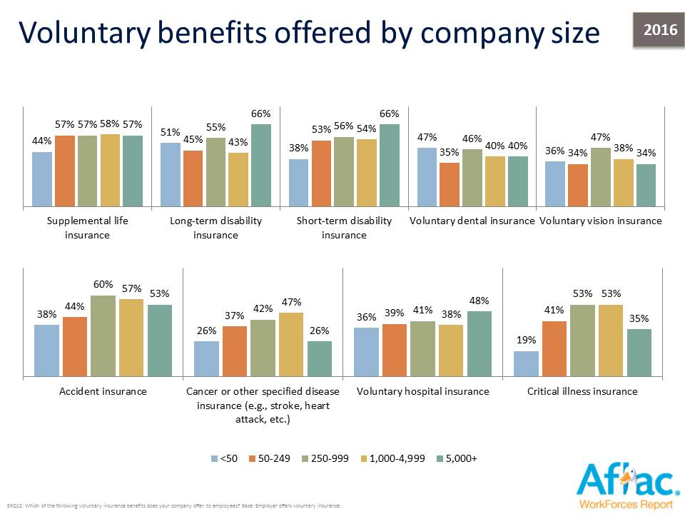
Notes:
Here’s a deep-dive look at voluntary products available by size of company.

Slide 30
Notes:
We asked employers why they offer voluntary benefits, and not surprisingly, many said it is to satisfy employees, but look at the increases in the other areas too.

Slide 31
Notes:
We asked employers who do NOT offer voluntary, why. Here is what they told us.

Slide 32
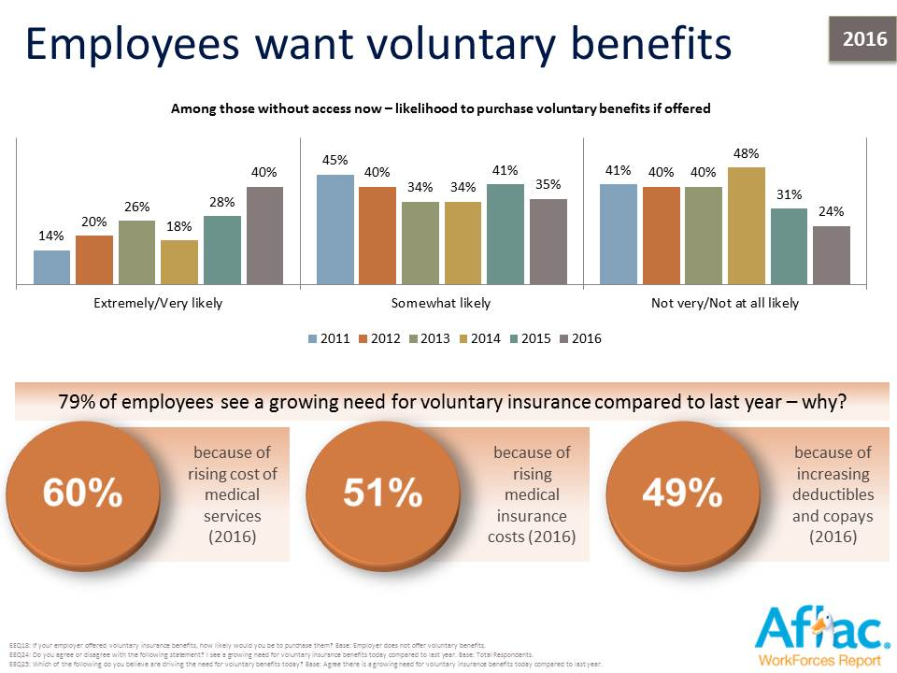
Notes:
BUT employees tell us they want voluntary benefits.

Slide 33
Notes:
Need further proof of the value of voluntary?

Slide 34
Notes:
For years, there has been talk about the connection between voluntary benefits and workers comp claims. So we asked employers to tell us…

Slide 36
Learn more at: Aflac.com > Resources > Aflac WorkForces Report
Ask about co-branding AWR collateral.
Articles
Infographics
Fact Sheets
Executive Summary
Notes:
More resources are available on aflac.com.

