Slide 1
Trending Data
AWR 2011-2014

Slide 2
Content within is for informational purposes only. The 2014 Aflac WorkForces Report is the fourth annual Aflac employee benefits study examining benefit trends and attitudes. The study, conducted in January 2014 by Research Now on behalf of Aflac, captured responses from 1,856 benefits decision-makers and 5,209 employees from across the United States.
This material within is intended to provide general information about an evolving topic and does not constitute legal, tax or accounting advice regarding any specific situation. Aflac cannot anticipate all the facts that a particular employer or individual will have to consider in their benefits decision-making process. We strongly encourage readers to discuss their HCR situations with their advisors to determine the actions they need to take or to visit healthcare.gov (which may also be contacted at 800-318-2596) for additional information.

Slide 3
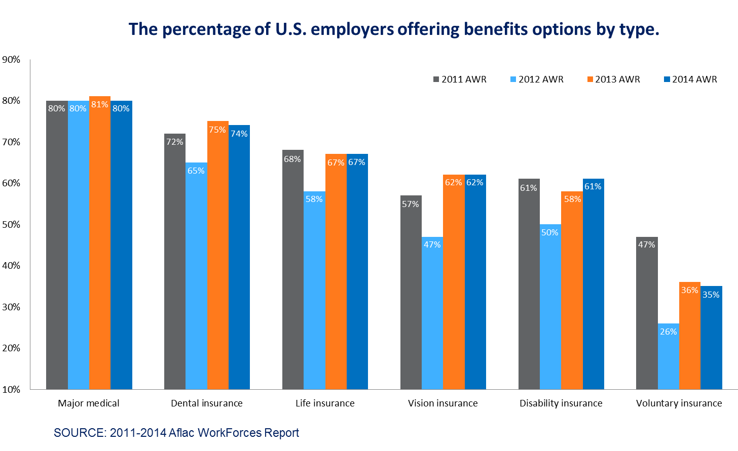
Z140466
5/14

Slide 4
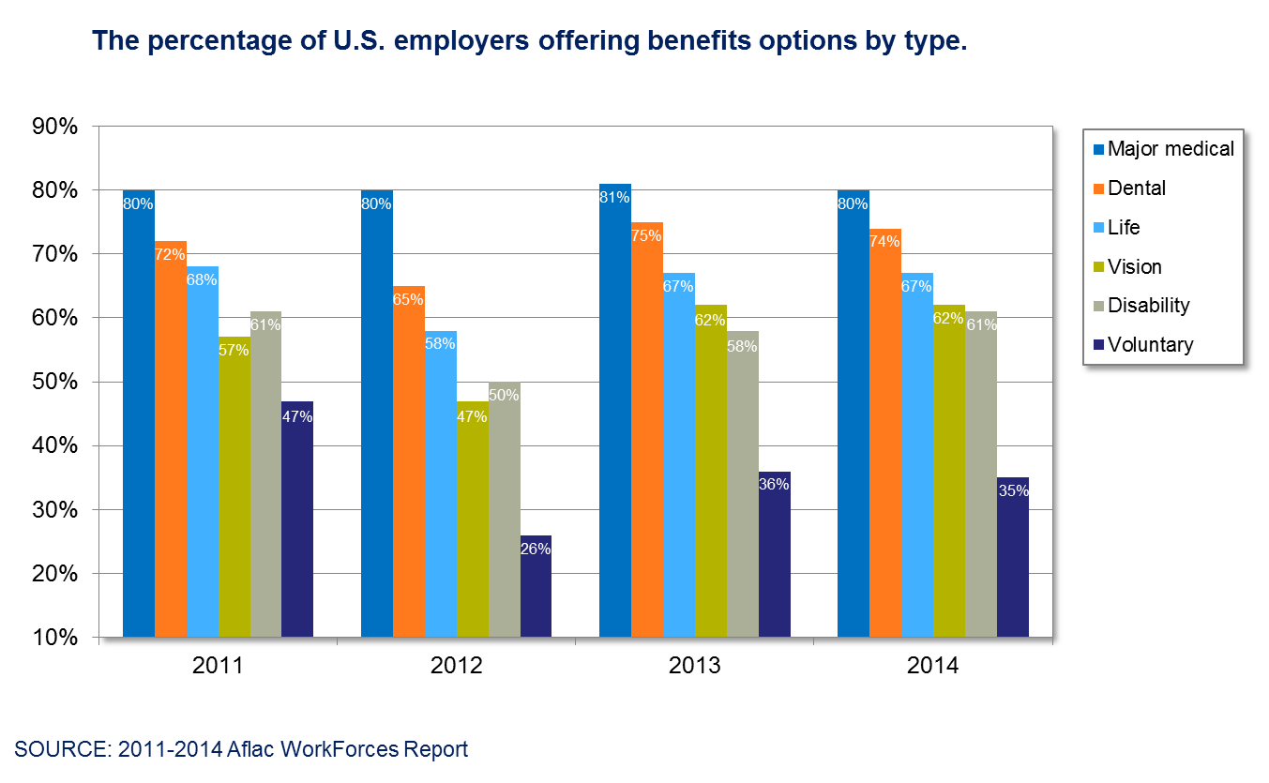
Z140467
5/14

Slide 5
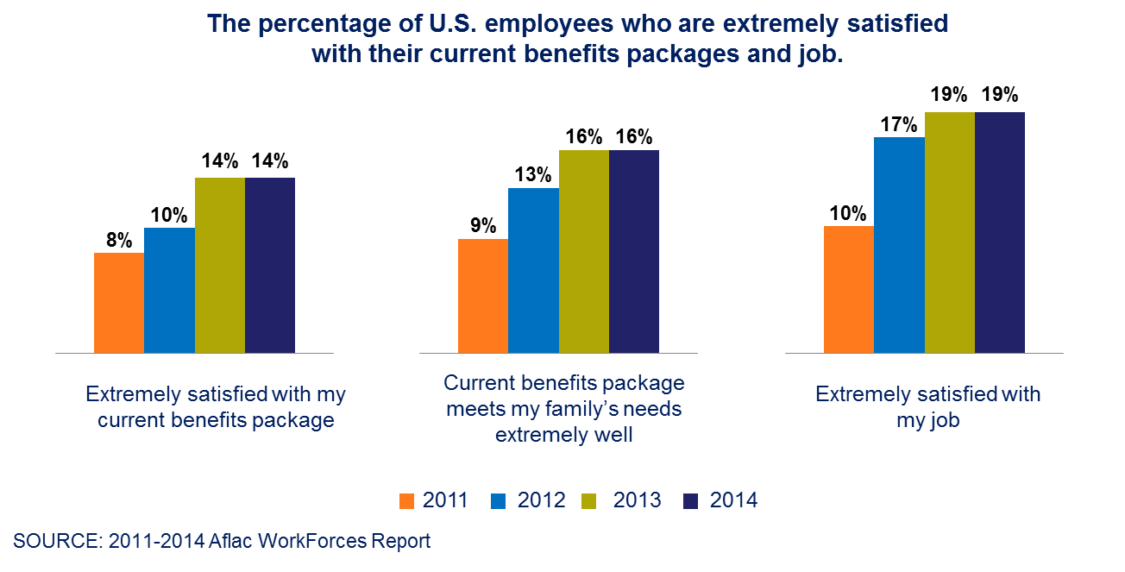
Plenty of room for improvement!
Z140468
5/14

Slide 6
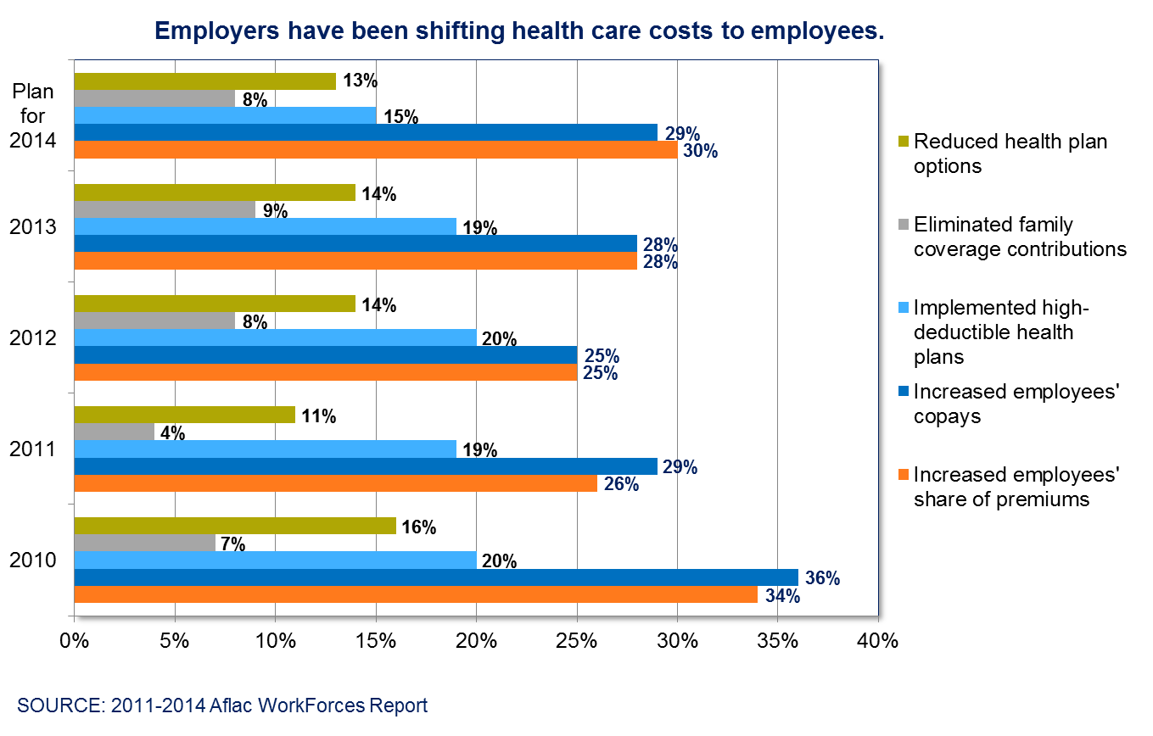
Z140469
5/14

Slide 7
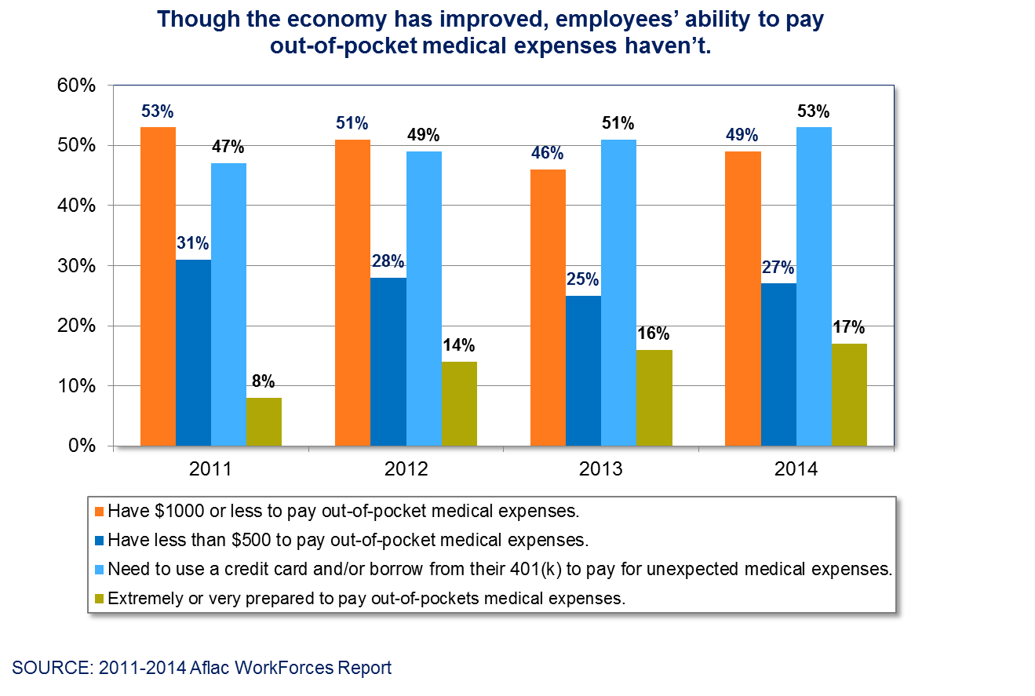
Z140470
5/14

Slide 8
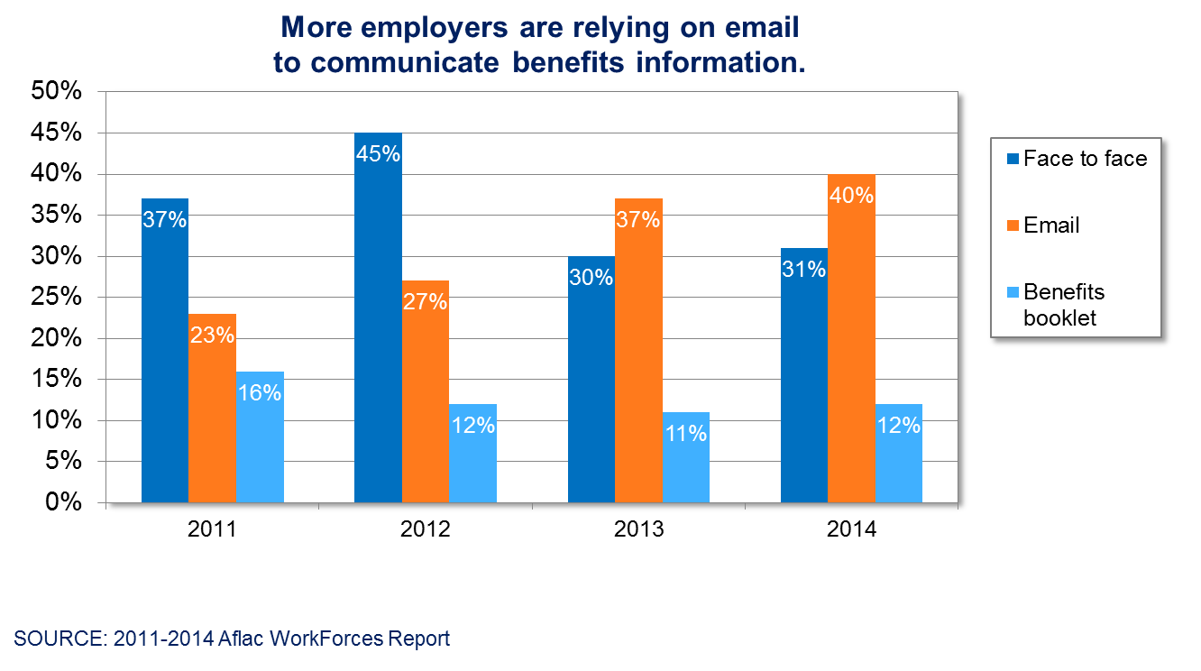
17 percent increase in use of email since 2011.
Z140471
5/14

Slide 9
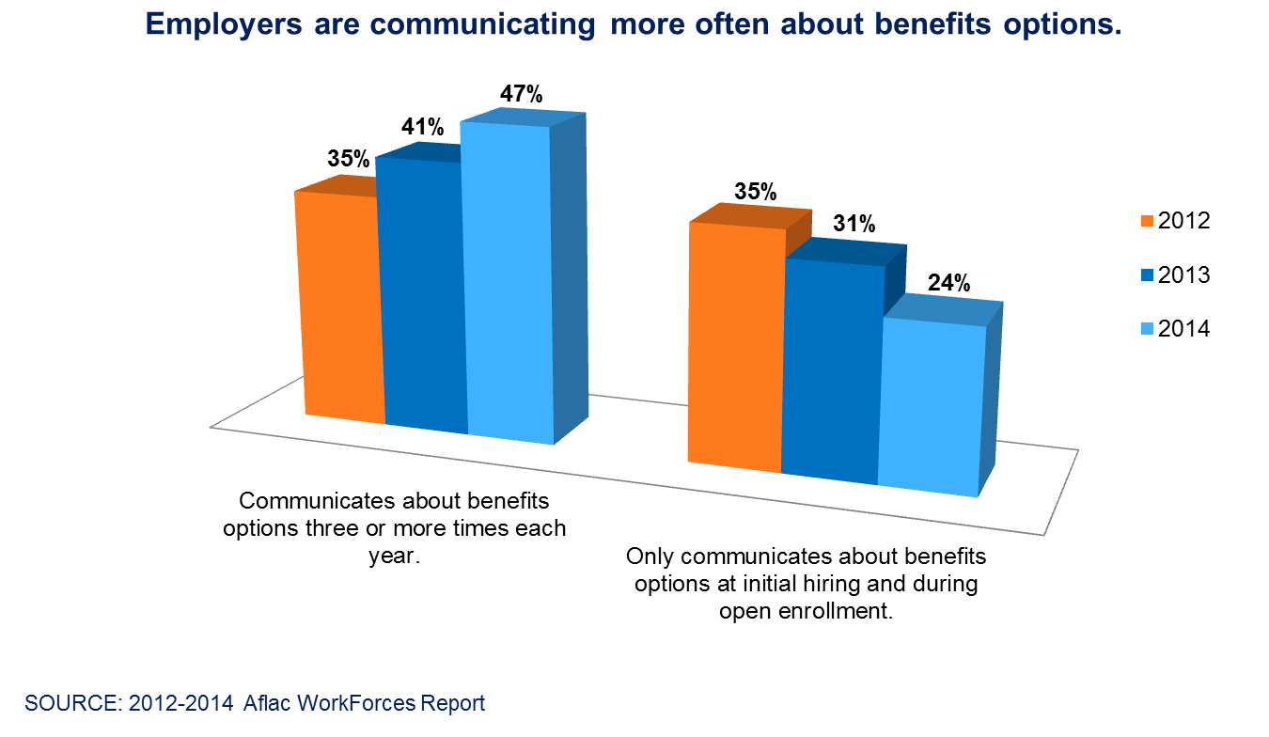
Z140472
5/14

Slide 10
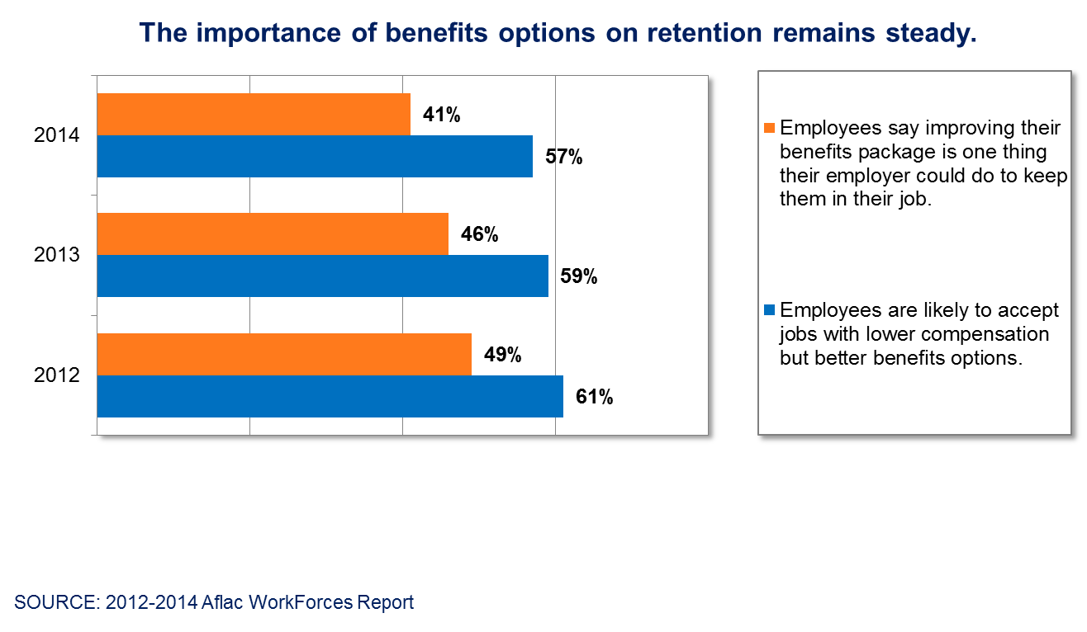
Z140473
5/14

